Slide 1
THE TOTAL SOCCER APP
Abhijit Gokhale
Shubham Sharma

Slide 2
OBJECTIVES
Soccer Data Conceptual & Logical Modeling
Soccer Data Acquisition
Historical Soccer Data Understanding
Microsoft PowerApps - Visualize Soccer Data (External Layer)
Audience - anyone interested in knowing about current Soccer leagues/players/teams.

Slide 3
TABLE OF CONTENTS
1
2
3
4
MODELING
DATABASE
Conceptual & Logical Modeling
Inserting the data into tables
POWERAPPS
CONCLUSION
Creating the interface of our Total Soccer App
How this App can be used?

Slide 4
DATA MODELING
CONCEPTUAL DATA MODELING
LOGICAL DATA MODELING

Slide 5
CONCEPTUAL DATA MODELING
In this phase, we understood our data requirements and defined our problem formally.
We prioritize our requirements according to the business needs.
We identified our entities with attributes and relationships among themselves.
We drew a Crow’s Foot E-R diagram and using that, designed our Logical Model.

Slide 6
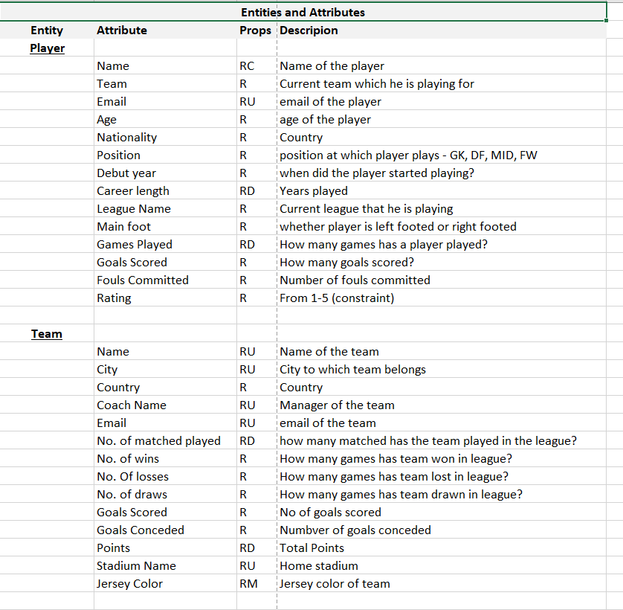
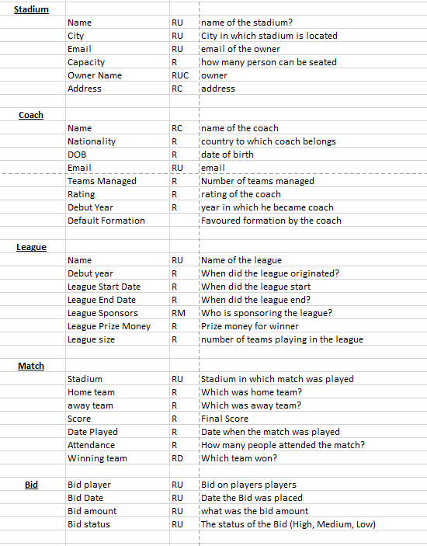
ENTITIES

Slide 7
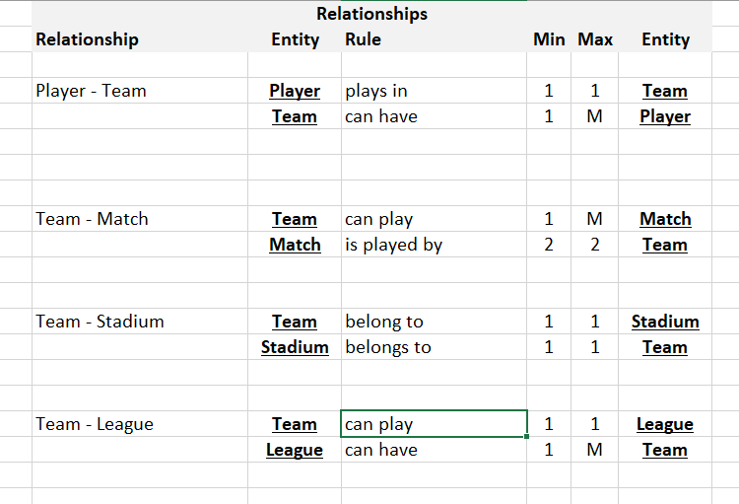
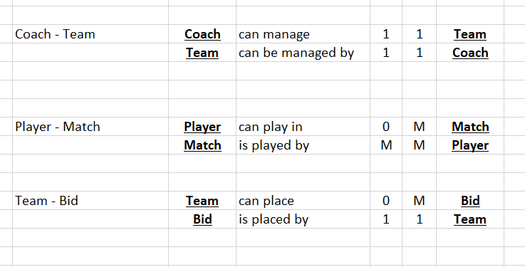
RELATIONSHIPS

Slide 8
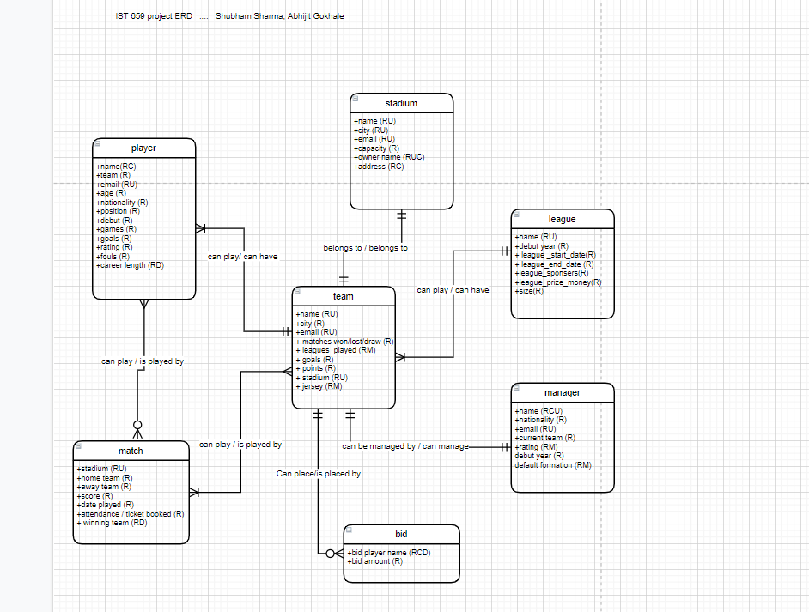
CROW’S FOOT E-R DIAGRAM
Entities -
Player
Match
Stadium
Team
Manager
Bid
League

Slide 9
LOGICAL DATA MODELING
In this phase, we implemented our Conceptual Data Model using a relational database model.
So, we defined our tables, columns, keys and constraints.
We mapped the entities to tables and mapped the attributes.

Slide 10
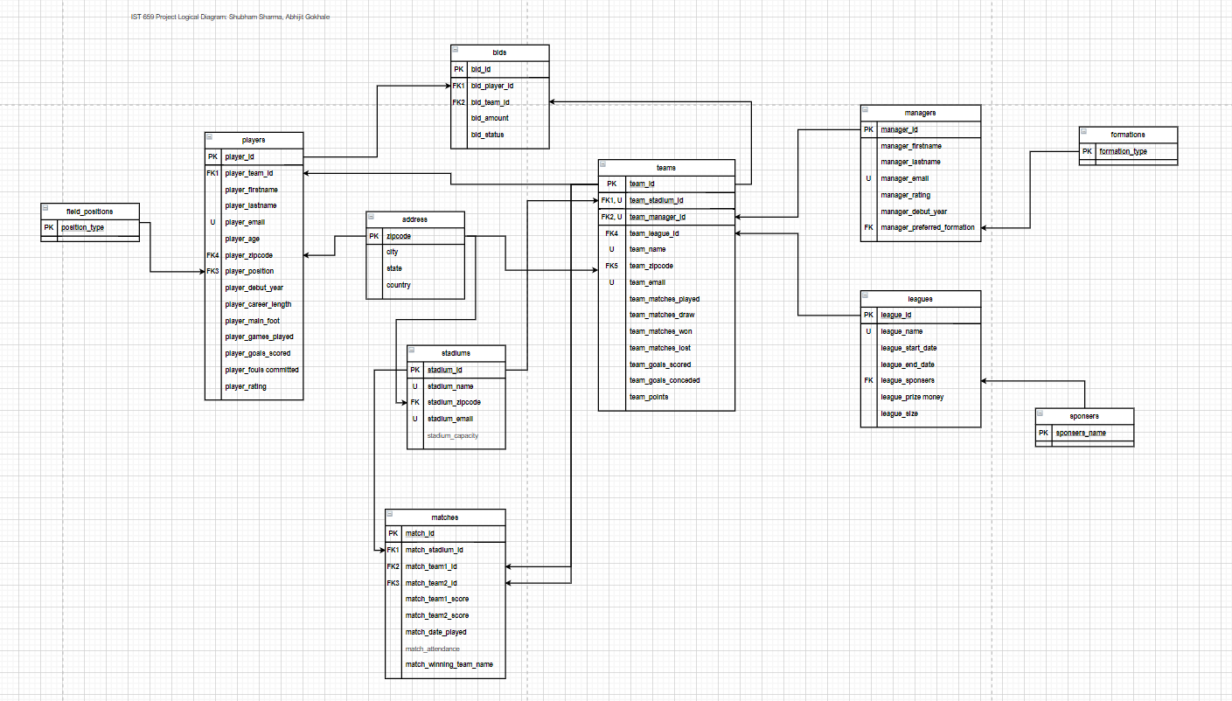

Slide 11
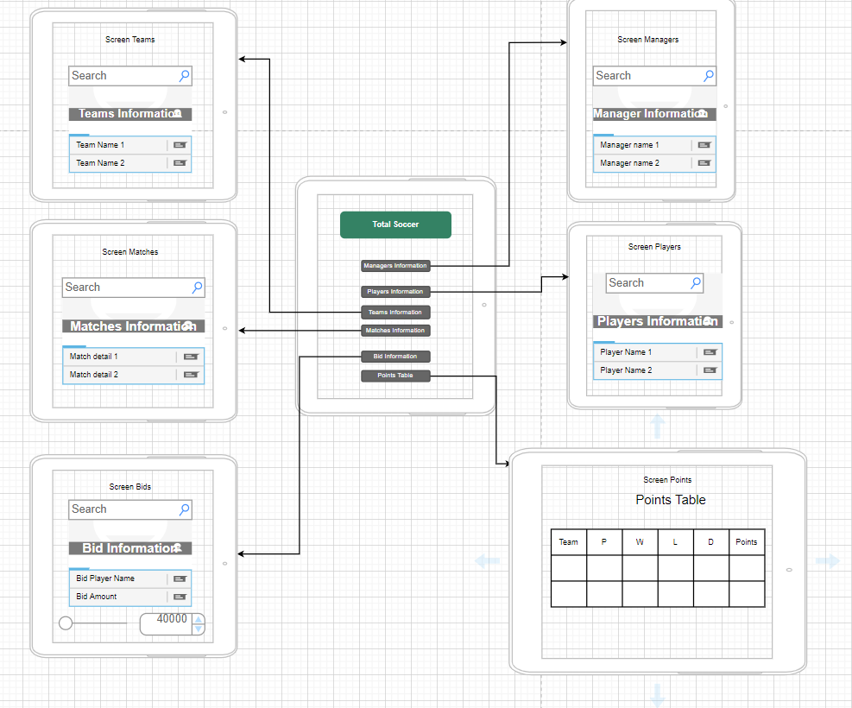
SCREENS DESIGN

Slide 12
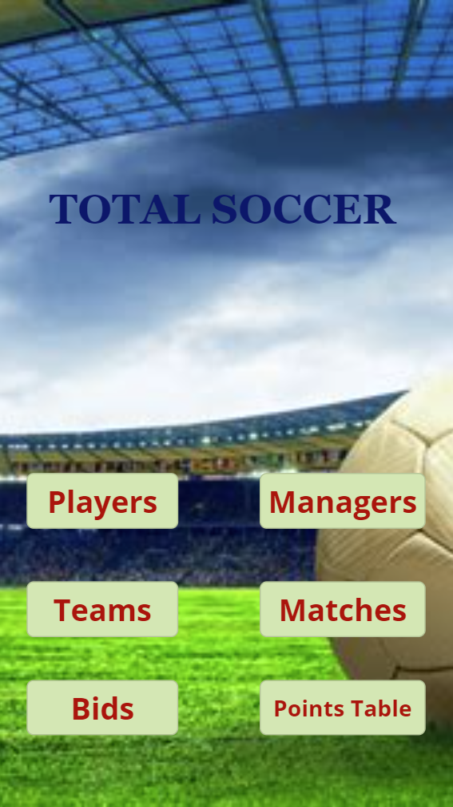
MOBILE APP - MAIN SCREEN

Slide 13
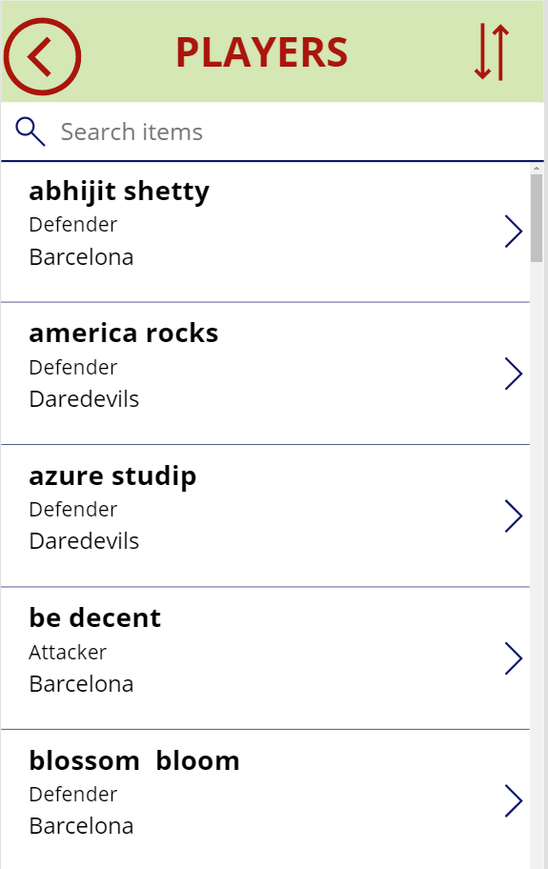
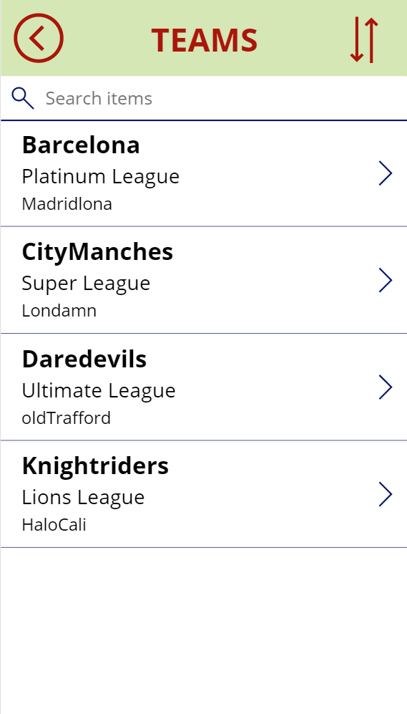
PLAYERS INFO
TEAMS INFO

Slide 14
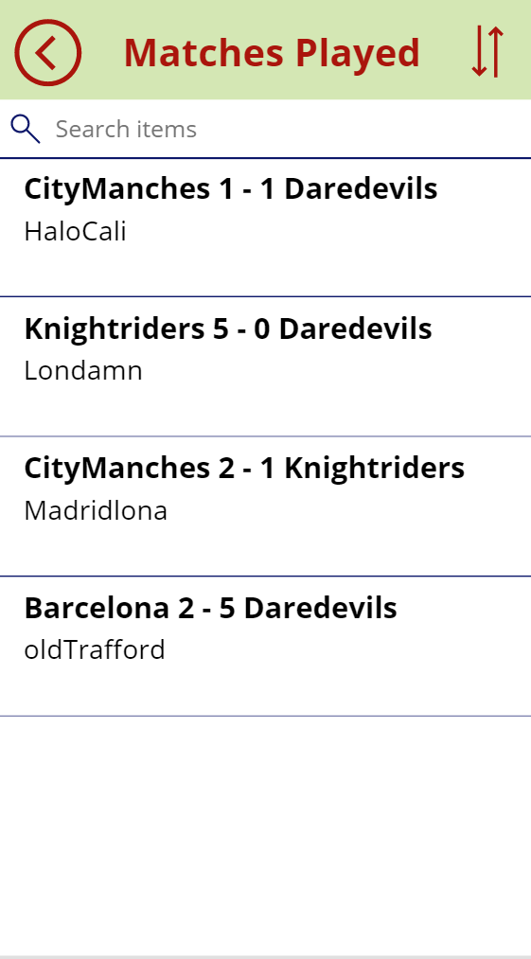
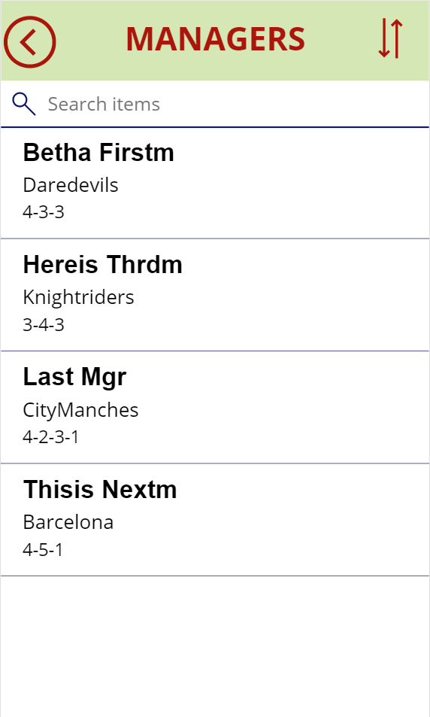
MATCHES INFO
MANAGERS INFO

Slide 15
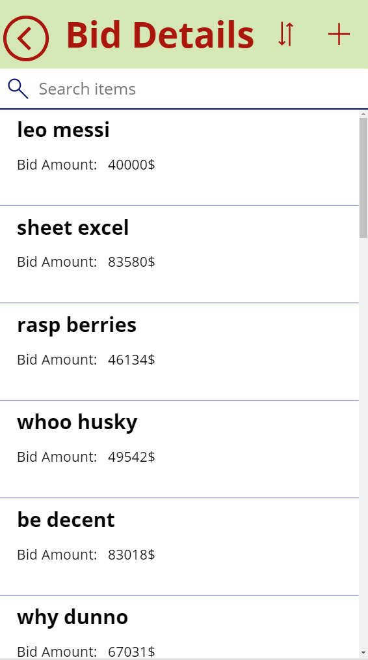
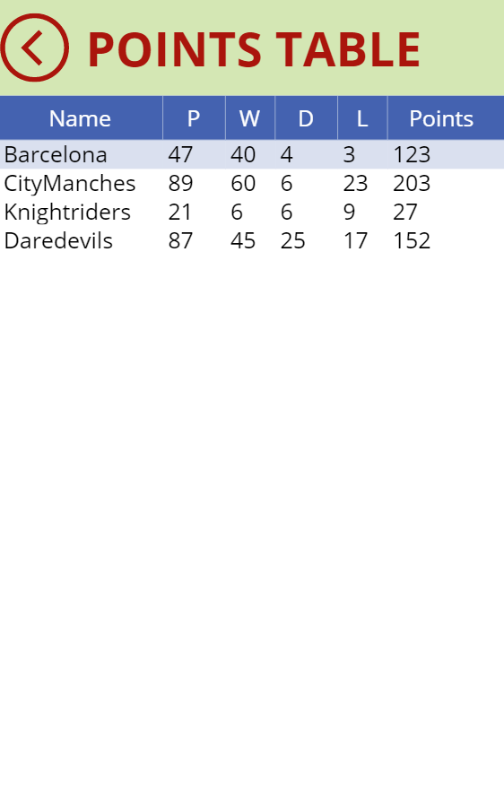
BIDS INFO
POINTS TABLE

Slide 16
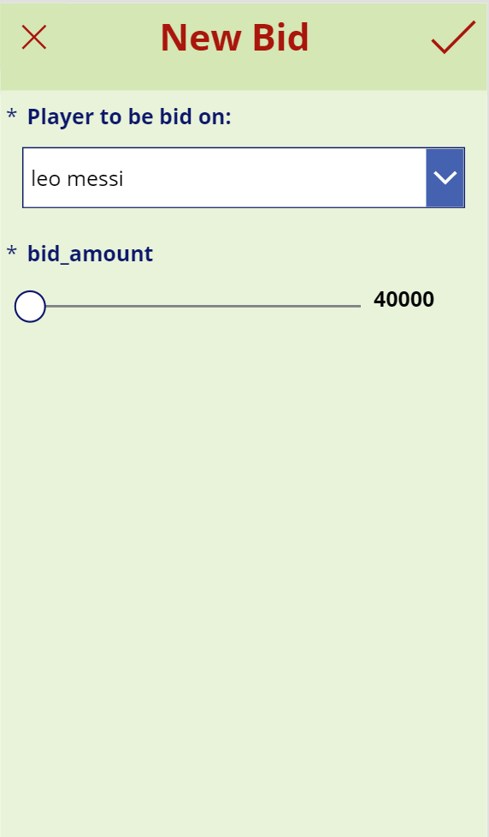
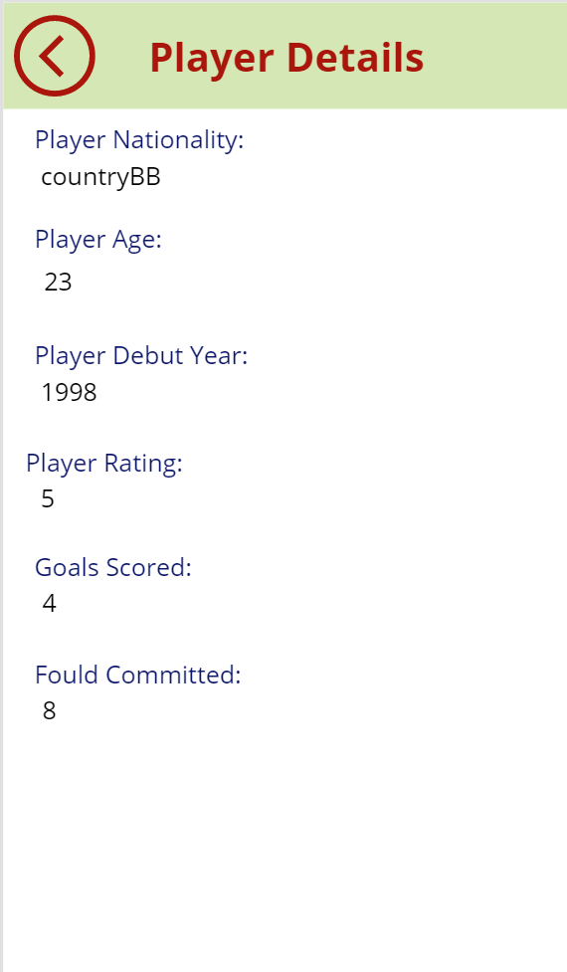
MAKE A BID
INDIVIDUAL PLAYER

Slide 17
CONCLUSIONS
We created a database that a person can use for keeping track of Soccer matches held in 8 leagues in USA.
Our objective was to make available players info, managers info, teams info so that a team can see players’ and managers’ rating and their performance and decide to make a bid for the player.
The database structure is quite simple and scalable, which makes it easy for also other programmers to understand it.
While doing this project we understood this information can be used for understanding existing soccer data. We can leverage this information to perform predictive analysis and reporting.
We gained deeper understanding on database design and how it can be implemented in real life situations using Microsoft PowerApps.

Slide 18

THANKS

